Slide 1
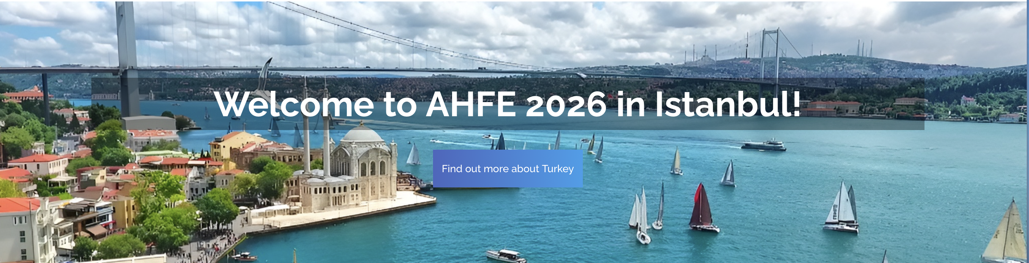

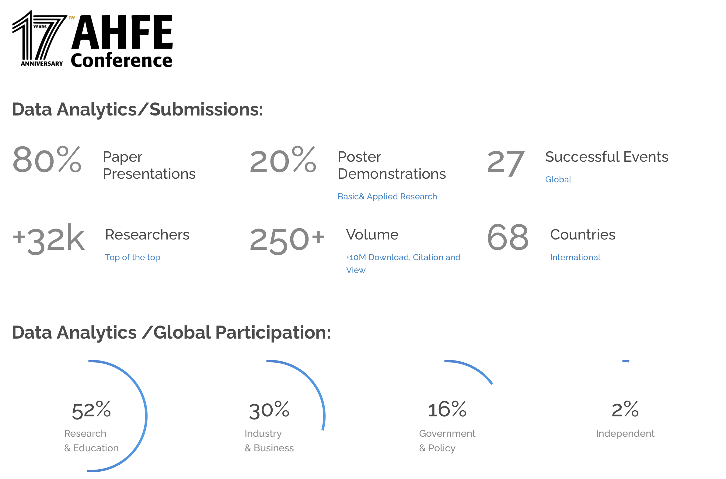

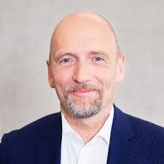
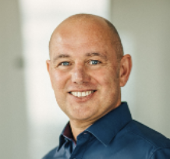
13th International Conference on The Human Side of Service Engineering
Service Ecosystem Engineering (SESE) to Overcome Translational Gaps
in Digital Transformation
Volker Gruhn
Markus Warg

Slide 2
Agenda
Translational Gaps in Digital Transformation
Challenge
Service (Eco) System Engineering (SESE)
Centrality of Service and SDA
Example
Findings & Outlook
// 2

Slide 3
DISCONNECTS BETWEEN TECHNOLOGICAL CAPABILITIES AND REALIZED VALUE
1. TRANSLATIONAL GAPS IN DIGITAL TRANSFORMATION
#LEAD TO MAJOR CHALLENGES FOR SOCIETY AND ECONOMY
Customer
Company
Partner
Evolved, closed, monolithic application landscapes dominate and constrain organizations’ adaptability and business agility, e.g.:
Frictions in adapting and connecting new technologies
Frictions in translating scientific discoveries and new technologies (e.g. AI) into innovative offerings
Offering
Technology
-dominated
Social & Business Needs
Scientific discoveries &
digital technologies
offer
adapt
Failure rates of digital initiatives 70 % - 95 %
// 3

Slide 4



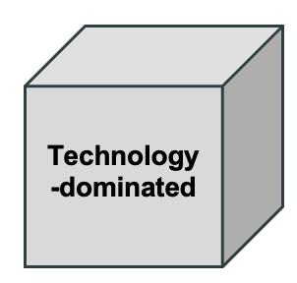
2. Challenge: HOW TO OVERCOME TRANSLATIONAL GAPS?
#FROM TECHNOLOGY-DOMINATED TO SERVICE-DOMINATED
?
Technology-dominated
Service-dominated
Customer X
Company
Partner
Customer X
Partner
Offering
Technology-dominated
Offering
Service-dominated
Company
Grown IT-landscapes, technology‑driven, complex, siloed, closed, monolithic, and slow.
Value chain: partners as transactional suppliers feeding into existing corporate value chains.
Customer‑ and service‑dominated, adaptive and cooperative in the sense of collaborative value creation (value cocreation).
Value constellation: relational, continuously building and deepening data-driven relationships.
// 4

Slide 5
PARADIGM SHIFT. FROM TECH-DOMINATED - TO SERVICE-DOMINATED DIGITAL TRANSFORMATION
3. SERVICE (ECO) SYSTEM ENGINEERING
SERVICES AS STRUCTURING PARADIGM OF CHOICE FOR BUSINESS PROCESSES AND IT
The Service (Eco) System Engineering (SESE) approach
links Service Design and Software Engineering to enable the purposive development of value constellation, initially independent of any specific technology,
builds on Service Dominant Architecture (SDA) as a reference structure for both service design and software engineering,
marks a shift from technology‑dominated initiatives to structure‑dominated, service‑based architectures that help organizations learn and evolve with each new requirement and use case.
Volker Gruhn
Volker Gruhn
// 5

Slide 6
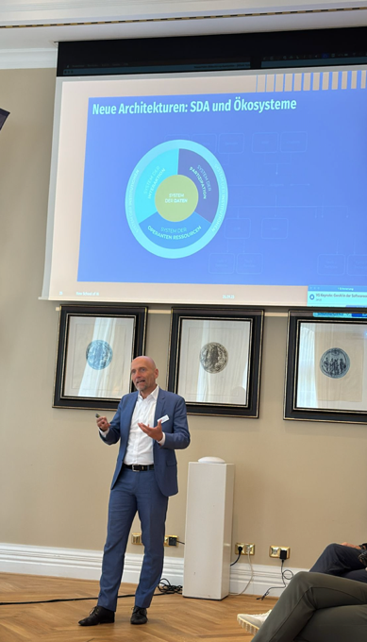
PARADIGM SHIFT. FROM TECH-DOMINATED - TO SERVICE-DOMINATED DIGITAL TRANSFORMATION
3. SERVICE (ECO) SYSTEM ENGINEERING
SERVICES AS STRUCTURING PARADIGM OF CHOICE FOR BUSINESS PROCESSES AND IT
We work with Service Dominant Architecture (SDA) to align business and IT
around a shared structure:
Design from the customer perspective (Service Design)
-> working backwards processes and roles (customer, partner, company)
Derive the necessary services and assign them to the five SDA systems:
-> interaction, participation, data, rules, and own capabilities.
Develop reusable services (Software Engineering)
-> engineered to be modular, reusable, and combinable.
They can be easily accessed, orchestrated, and scaled across use cases.
This reduces complexity and accelerates time-to-market.
Instead of technology-induced complexity, the structured, reusable, and
combinable services create room for service innovations.
Volker Gruhn
www.linkedin.com/in/volkergruhn/
Volker Gruhn
// 6

Slide 7
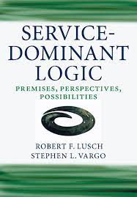
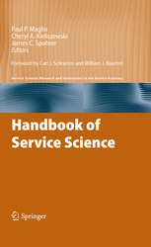
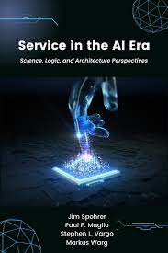
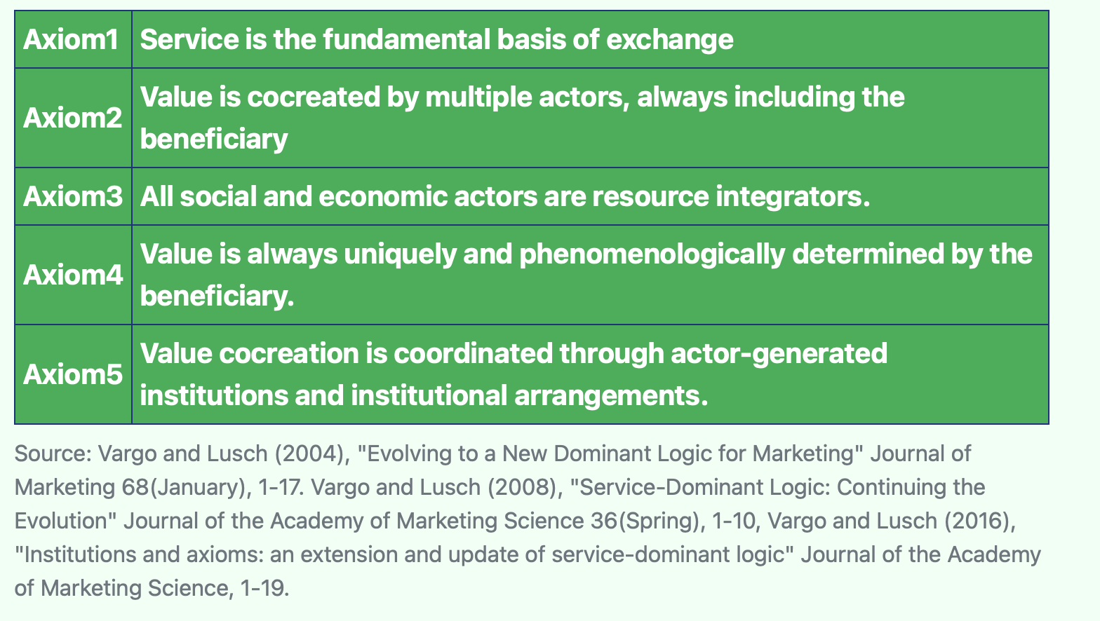
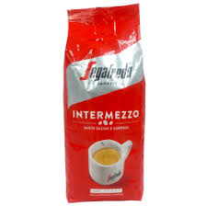


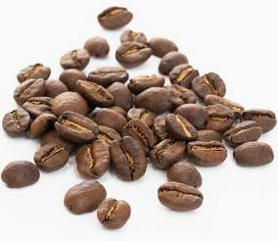

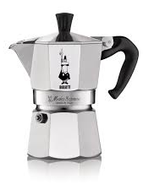
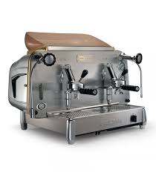

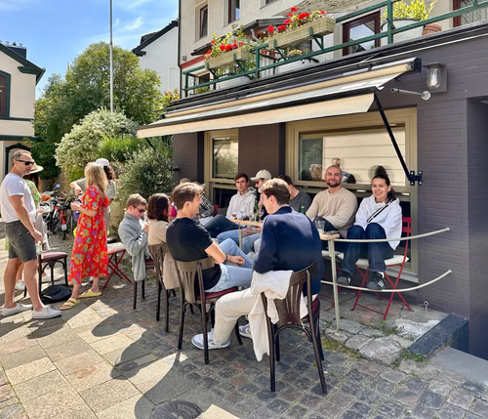




4. CENTRALITY OF SERVICE AND SDA
SERVICE is the application of resources (e.g., technology, goods, data, knowledge) for the benefit of another actor and/or oneself and CONNECTS EVERYONE OF US TO THE WORLD AROUND US.
// 7

Slide 8
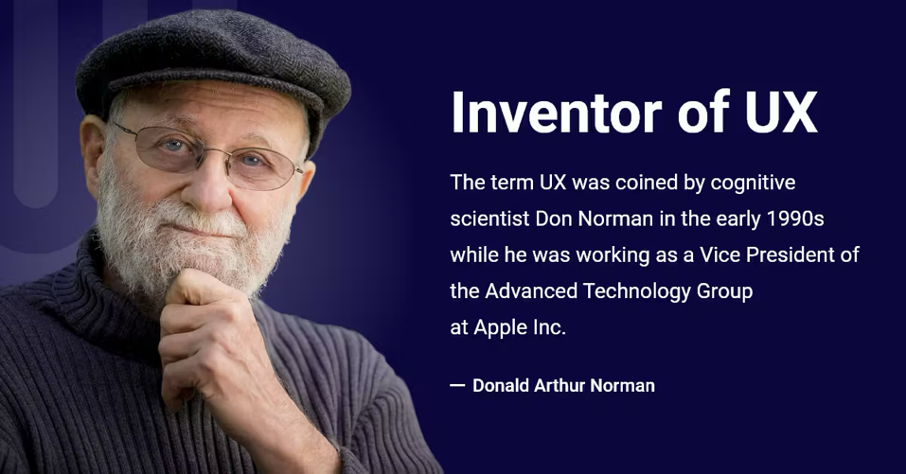
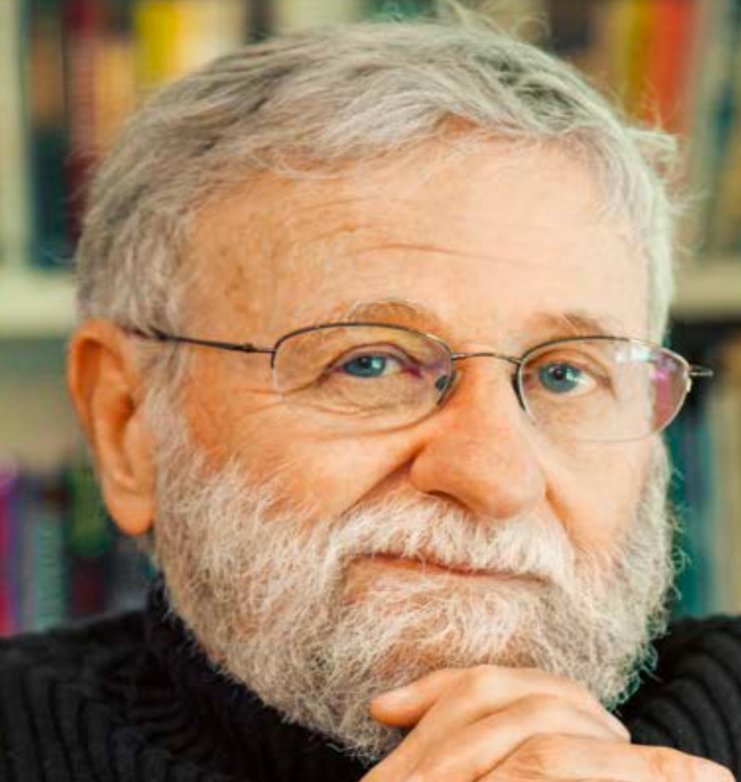
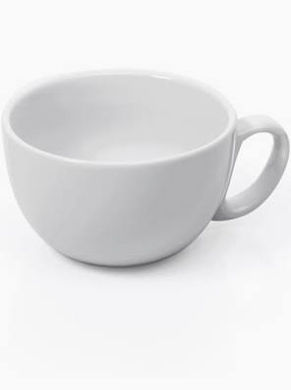
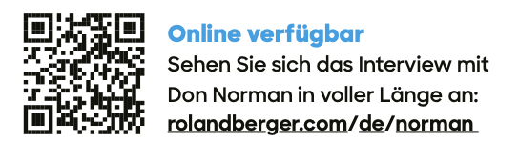
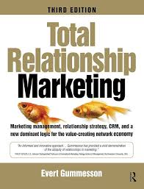
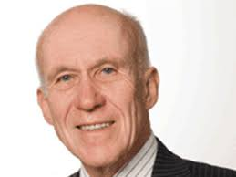
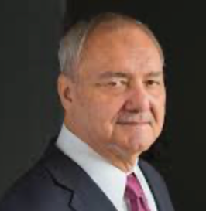

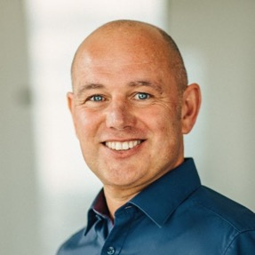
4. CENTRALITY OF SERVICE AND SDA
#SERVICES, SERVICE, SERVICE SYSTEMS, SDA
Don Norman (ex UX Apple): „The idea is to focus not on selling products but on offering services. Every product ultimately contains a service. I buy a cup because it holds a drink and keeps it warm.“ (Normann, D. (2024), p.77)
Evert Gummesson: „activities render services, things render services.“
Gummesson, E. (1995), p.251)
Steve Vargo: Founder Service-Dominant Logic (S-D Logic). S-D Logic offered a coherent way for these thoughts. Goods, activities, technologies and all the other resources and their services are integrated and replaced by service (in the singular). S-D Logic is the process and narrative of value co-creation.
Jim Spohrer: Founder Service Science. Service Science models service and its essential inter-relationships and abstracts them as service systems (responsible actors) interconnected by value propositions, viewed as an evolving ecology.
Markus Warg: Founder Service Dominant Architecture (SDA) which is derived from S-D Logic and Service Science.
SDA facilitates the process and narrative of value cocreation from service design to engineering and implementation.
As structure SDA is medium (plan) and output (result) of the services and processes it recursively organizes.
// 8

Slide 9
Service (Eco) System Engineering
5. EXAMPLE OVB HOLDING: AI-BASED TRAINING
Service Dominant Architecture (SDA)
AI-based training and qualification of sales teams (OVB Case)
1
The sales representative authenticates and gains access to learning area, including all relevant documents
SYSTEM OF INSTITUTIONS
SYSTEM OF INSTITUTIONS
SYSTEM OF
OPERANT RESSOURCES
Customer
SYSTEM OF
INTERACTION
Partner
SYSTEM OF
PARTICIPATION
2
Company assigns the employee to the user group authorized to use the AI-based learning data, thereby automatically granting access to the AI chatbot.
SYSTEM OF
DATA
1
4
Offering
Value Proposition
3
3
AI partner provides its chatbot
4
The sales representative prepares for the exam.
Feedback provision after completing the certification
2
5
Operations & IT Landscape
5
OVB analyzes user feedback to further improve the solution.
Company
// 9

Slide 10
6. FINDINGS & OUTLOOK
SESE (Service (Eco)System Engineering) shifts digital transformation from technology‑dominated to service‑dominated practice using Service Dominant Architecture (SDA) as structure and unified reference for Service Design and Software Engineering.
SESE closes translational gaps by designing value‑creation systems around customers experience and aligning service design & software engineering with SDA’s five systems (interaction, data, participation, institutions, operant resources).
SESE decouples value from specific technologies makes organizations learning systems, enabling purposeful reconfiguration, continuous service innovation, emergent capabilities, and sustained value co‑creation.
// 10
Notes:
.

Slide 11
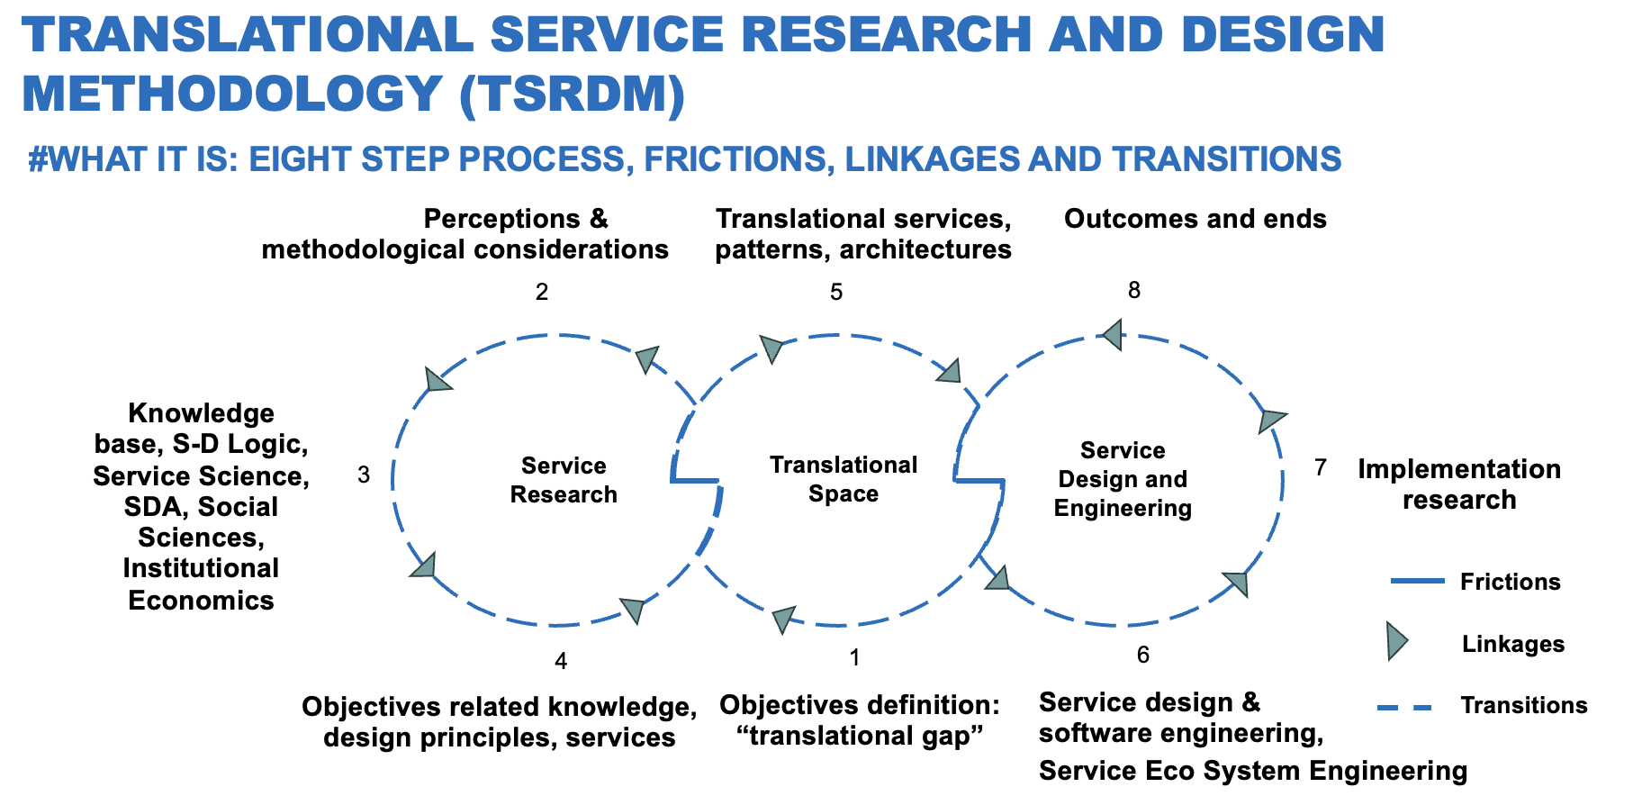
6. FINDINGS & OUTLOOK
As part of the “Translational Service Research and Design Methodology” initiative, future work should also address the reuse of “translational services and patterns” in the context of service design and software engineering.
// 11
Notes:
.

